Slide 1


Nrega Analysis using Tableau
Presented By : S Rohan
Mentorness| 2024

Slide 2
OVERVIEW
Abstract
Scope
Problem Statement
Result
Dataset Information
Variable Description
1
Mentorness| 2024

Slide 3
ABSTRACT
This project delves into the analysis of data related to the National Rural Employment Guarantee Act (NREGA), a transformative government scheme aimed at providing rural households with guaranteed wage employment opportunities. The dataset used for this analysis encompasses a wide range of
parameters, including the number of job cards issued, the workforce engaged, budget allocation, work completion statistics, and much more. Through the application of data analytics techniques, we aim to gain valuable insights into the implementation and impact of NREGA across different states and districts
in India.
2
Mentorness| 2024

Slide 4
PROBLEM STATEMENT
NREGA is a vital initiative to alleviate rural unemployment and poverty. This project seeks to address
several key questions and challenges associated with NREGA:
● How effective is NREGA in providing employment opportunities to rural households?
● Are there regional disparities in the implementation and outcomes of the scheme?
● What is the utilization of the allocated budget, and how does it correlate with
employment generation?
● What are the key factors contributing to the completion of NREGA works, and are there
any roadblocks to its success?
● Can data-driven insights guide policymakers and administrators in optimizing the
scheme's impact?
3
Mentorness| 2024

Slide 5
Dataset Information
The dataset used for this analysis is sourced from official government records and contains information
related to NREGA implementation across various states and districts in India. It comprises 28 columns,
encompassing data on job cards, worker details, budget allocation, work completion statistics,
expenditure, and more. This dataset offers a comprehensive view of the progress and challenges faced
by the NREGA program.
4
Mentorness| 2024

Slide 6
VARIABLE DESCRIPTION
The dataset consists of the following variables:
● state_name: Name of the Indian state.
● district_name: Name of the district within the state.
● Total No. of JobCards issued: The total number of job cards issued to rural households.
● Total No. of Workers: The total number of workers registered under NREGA.
● Total No. of Active Job Cards: The number of active job cards at a given point in time.
● Total No. of Active Workers: The number of workers currently engaged in NREGA works.
● SC workers against active workers: The count of Scheduled Caste workers among active workers.
● ST workers against active workers: The count of Scheduled Tribe workers among active workers.
● Approved Labour Budget: The budget allocated for labor under NREGA.
5
Mentorness| 2024

Slide 7
VARIABLE DESCRIPTION
● Persondays of Central Liability so far: The total persondays
of employment provided, considering central liability.
● SC persondays: Persondays of employment provided to Scheduled Caste workers.
● ST persondays: Persondays of employment provided to Scheduled Tribe workers.
● Women Persondays: Persondays of employment provided to women.
● Average days of employment provided per Household: The average number of days
of employment provided per rural household.
● Average Wage rate per day per person(Rs.): The average daily wage rate per NREGA worker
in Indian Rupees.
● Total No of HHs completed 100 Days of Wage Employment: The number of
households completing 100 days of wage employment.
Mentorness| 2024
6

Slide 8
VARIABLE DESCRIPTION
● Total Households Worked: The total number of households involved in NREGA works.
● Total Individuals Worked: The total number of individuals engaged in NREGA works.
● Differently abled persons worked: The count of differently abled persons who participated
in NREGA works.
● Number of GPs with NIL exp: The number of Gram Panchayats with zero expenditure.
● Total No. of Works Takenup (New+Spill Over): The total number of works initiated, including
new projects and spill-over from previous periods.
● Number of Ongoing Works: The count of works that are currently in progress.
● Number of Completed Works: The count of works that have been successfully completed.
● % of NRM Expenditure(Public + Individual): The percentage of expenditure on Natural
Resource Management (NRM) projects, including both public and individual contributions.
Mentorness| 2024
7

Slide 9
SCOPE
Phase 1
Phase 3
Data preprocessing and cleaning to ensure data quality.
Utilizing data visualization techniques to present key findings effectively.
Mentorness| 2024
Phase 2
Phase 4
Exploratory data analysis (EDA) to identify patterns, trends, and disparities in
NREGA implementation.
Drawing actionable insights to inform policymakers and administrators about the strengths
and weaknesses of the NREGA program.
8

Slide 10
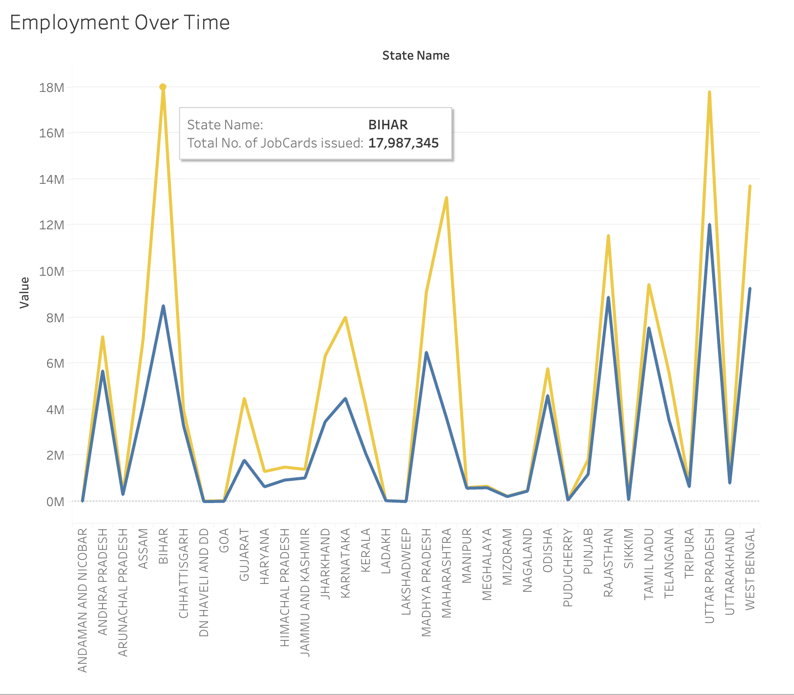
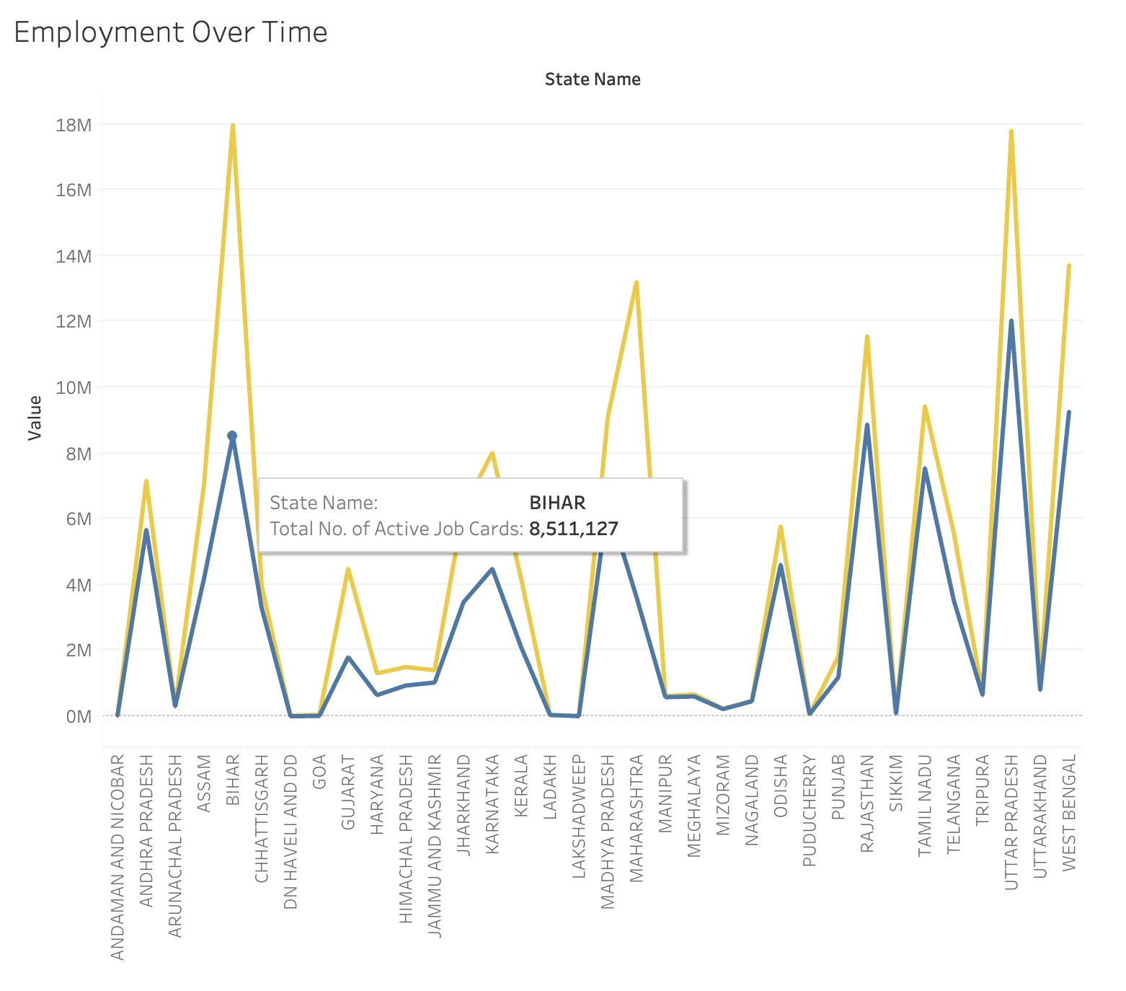
PROBLEM STATMENT
How effective is NREGA in providing employment opportunities to rural households?
Mentorness| 2024
9

Slide 11
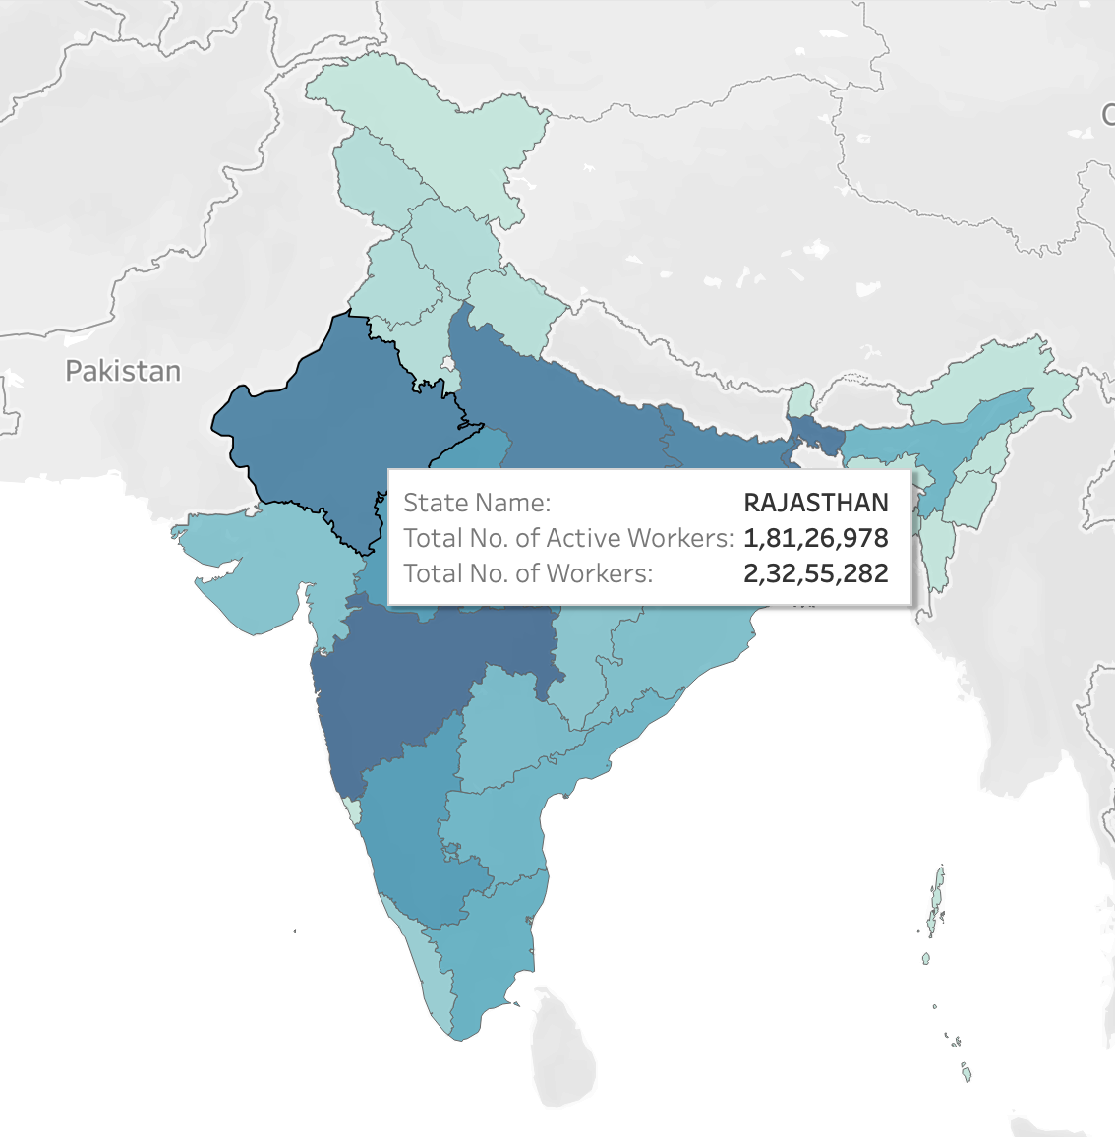
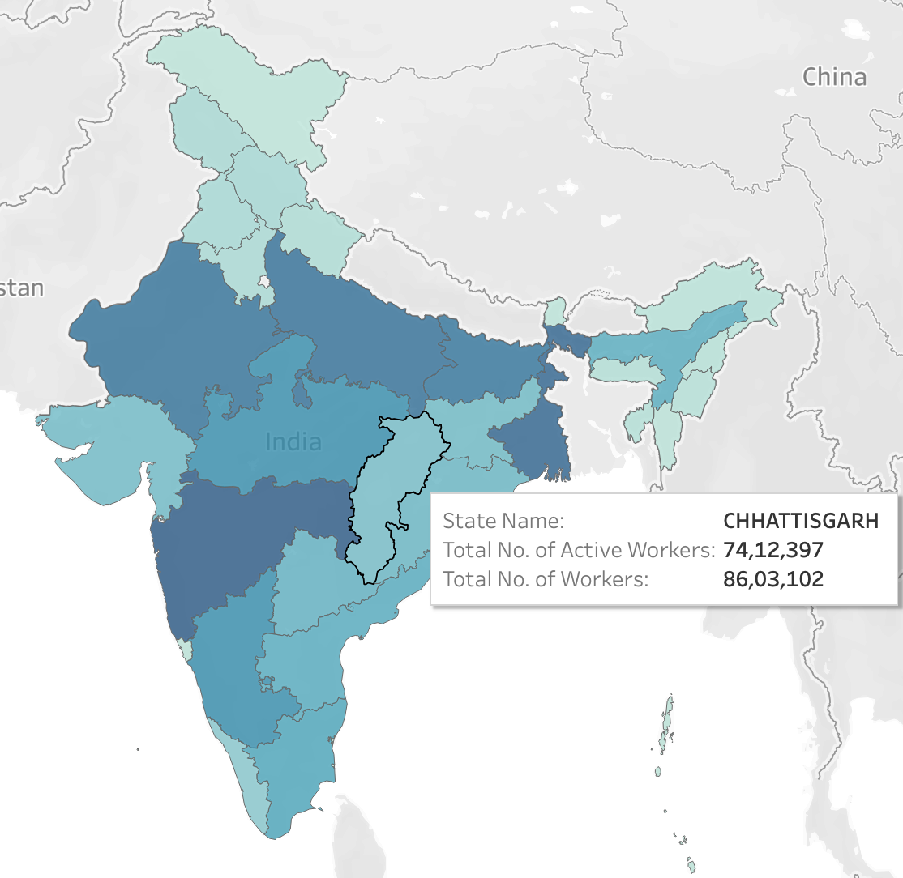
PROBLEM STATMENT
Are there regional disparities in the implementation and outcomes of the scheme?
Mentorness| 2024
10

Slide 12
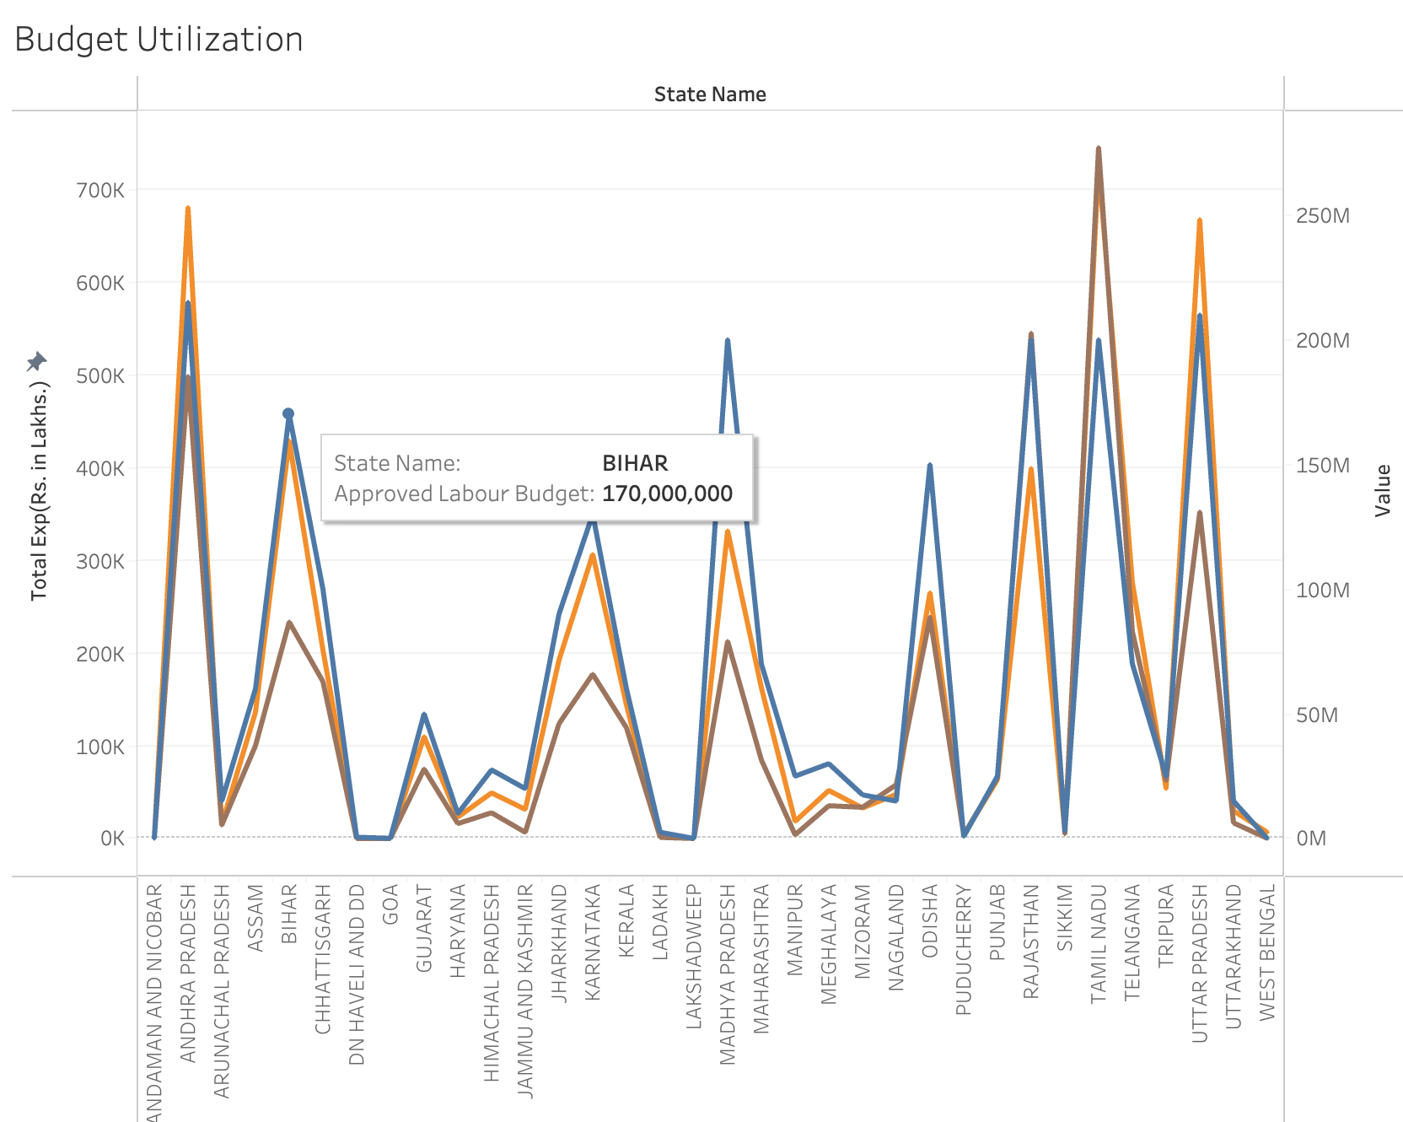
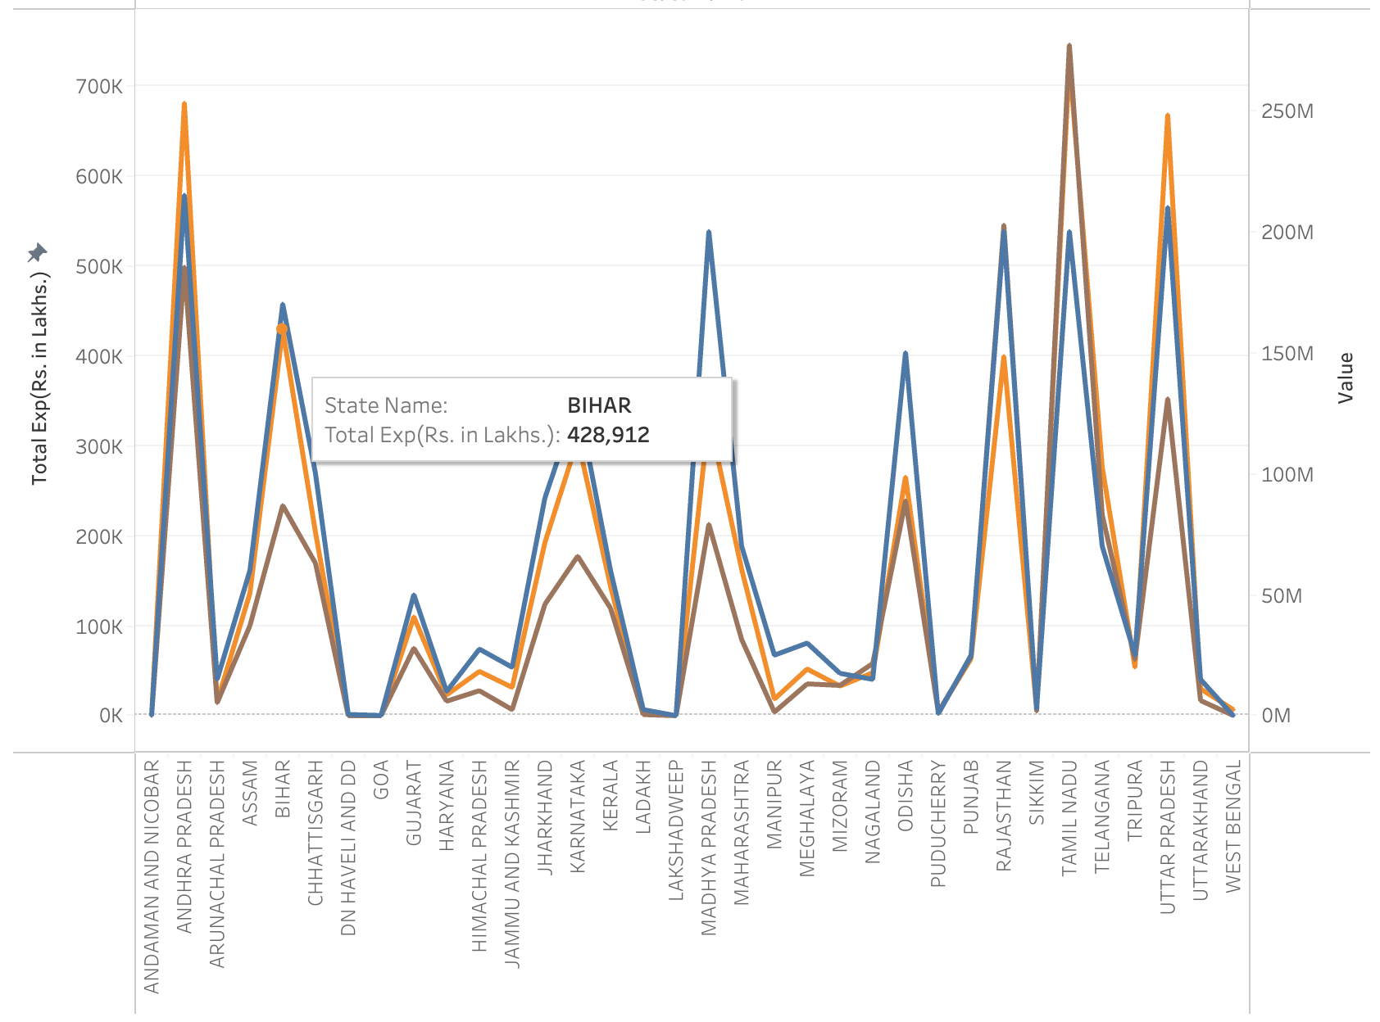
PROBLEM STATMENT
What is the utilization of the allocated budget, and how does it correlate with employment generation?
Mentorness| 2024
11

Slide 13
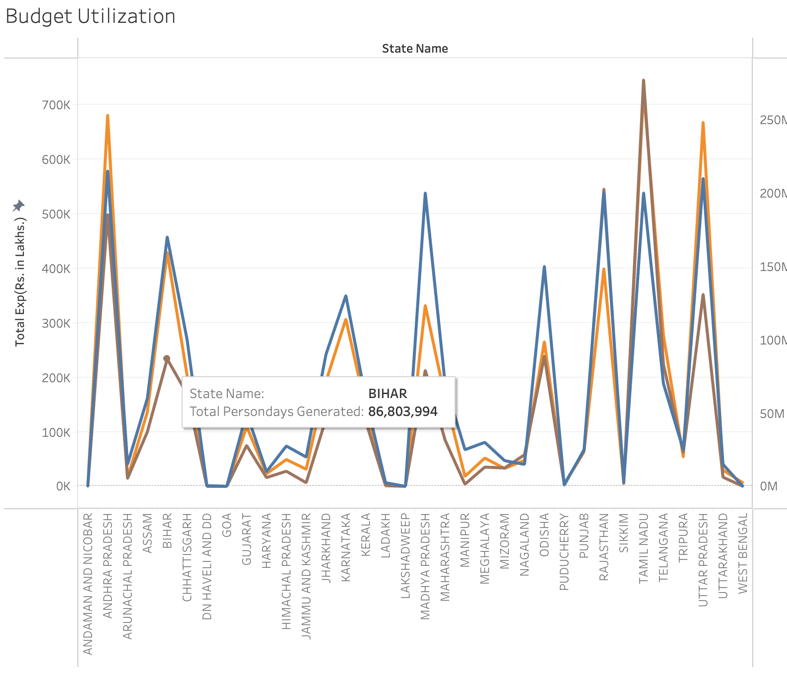
PROBLEM STATMENT
What is the utilization of the allocated budget, and how does it correlate with employment generation?
Mentorness| 2024
11

Slide 14
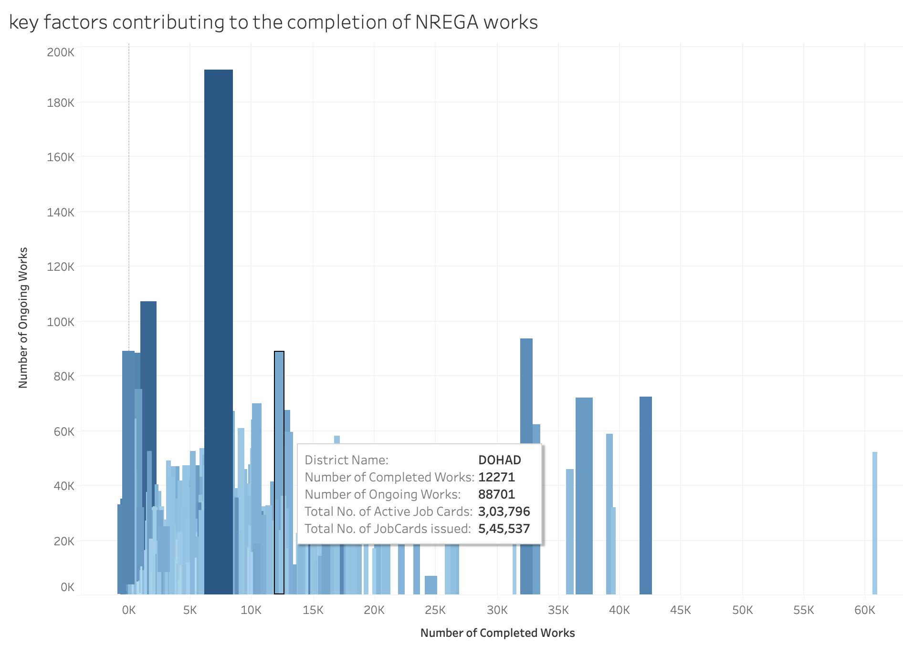
PROBLEM STATMENT
What are the key factors contributing to the completion of NREGA works, and are there any roadblocks to its success?
Mentorness| 2024
12

Slide 15
PROBLEM STATMENT
Can data-driven insights guide policymakers and administrators in optimizing the scheme's impact?
1.⁠ ⁠Identify Effective Resource Allocation:
- Budget Utilization: Analyze how funds are being used across different regions and projects. This helps identify areas where budget utilization is optimal and regions where funds may be underutilized or misallocated.
- Labor Distribution: Assess the distribution of labor resources to ensure that regions with higher demand are adequately staffed.
Mentorness| 2024
2.⁠ ⁠Highlight Regional Disparities:
- Use geographic visualizations to highlight disparities in employment, fund allocation, and project completion rates across different states and districts.
- Target interventions in regions that are lagging behind in terms of employment generation or project completion.
13

Slide 16
PROBLEM STATMENT
Can data-driven insights guide policymakers and administrators in optimizing the scheme's impact?
Mentorness| 2024
3.⁠ ⁠Monitor and Evaluate Project Performance:
- Track the progress of various projects to identify those that are on track, delayed, or completed.
- Implement real-time monitoring dashboards to quickly address issues and bottlenecks.
14

Slide 17
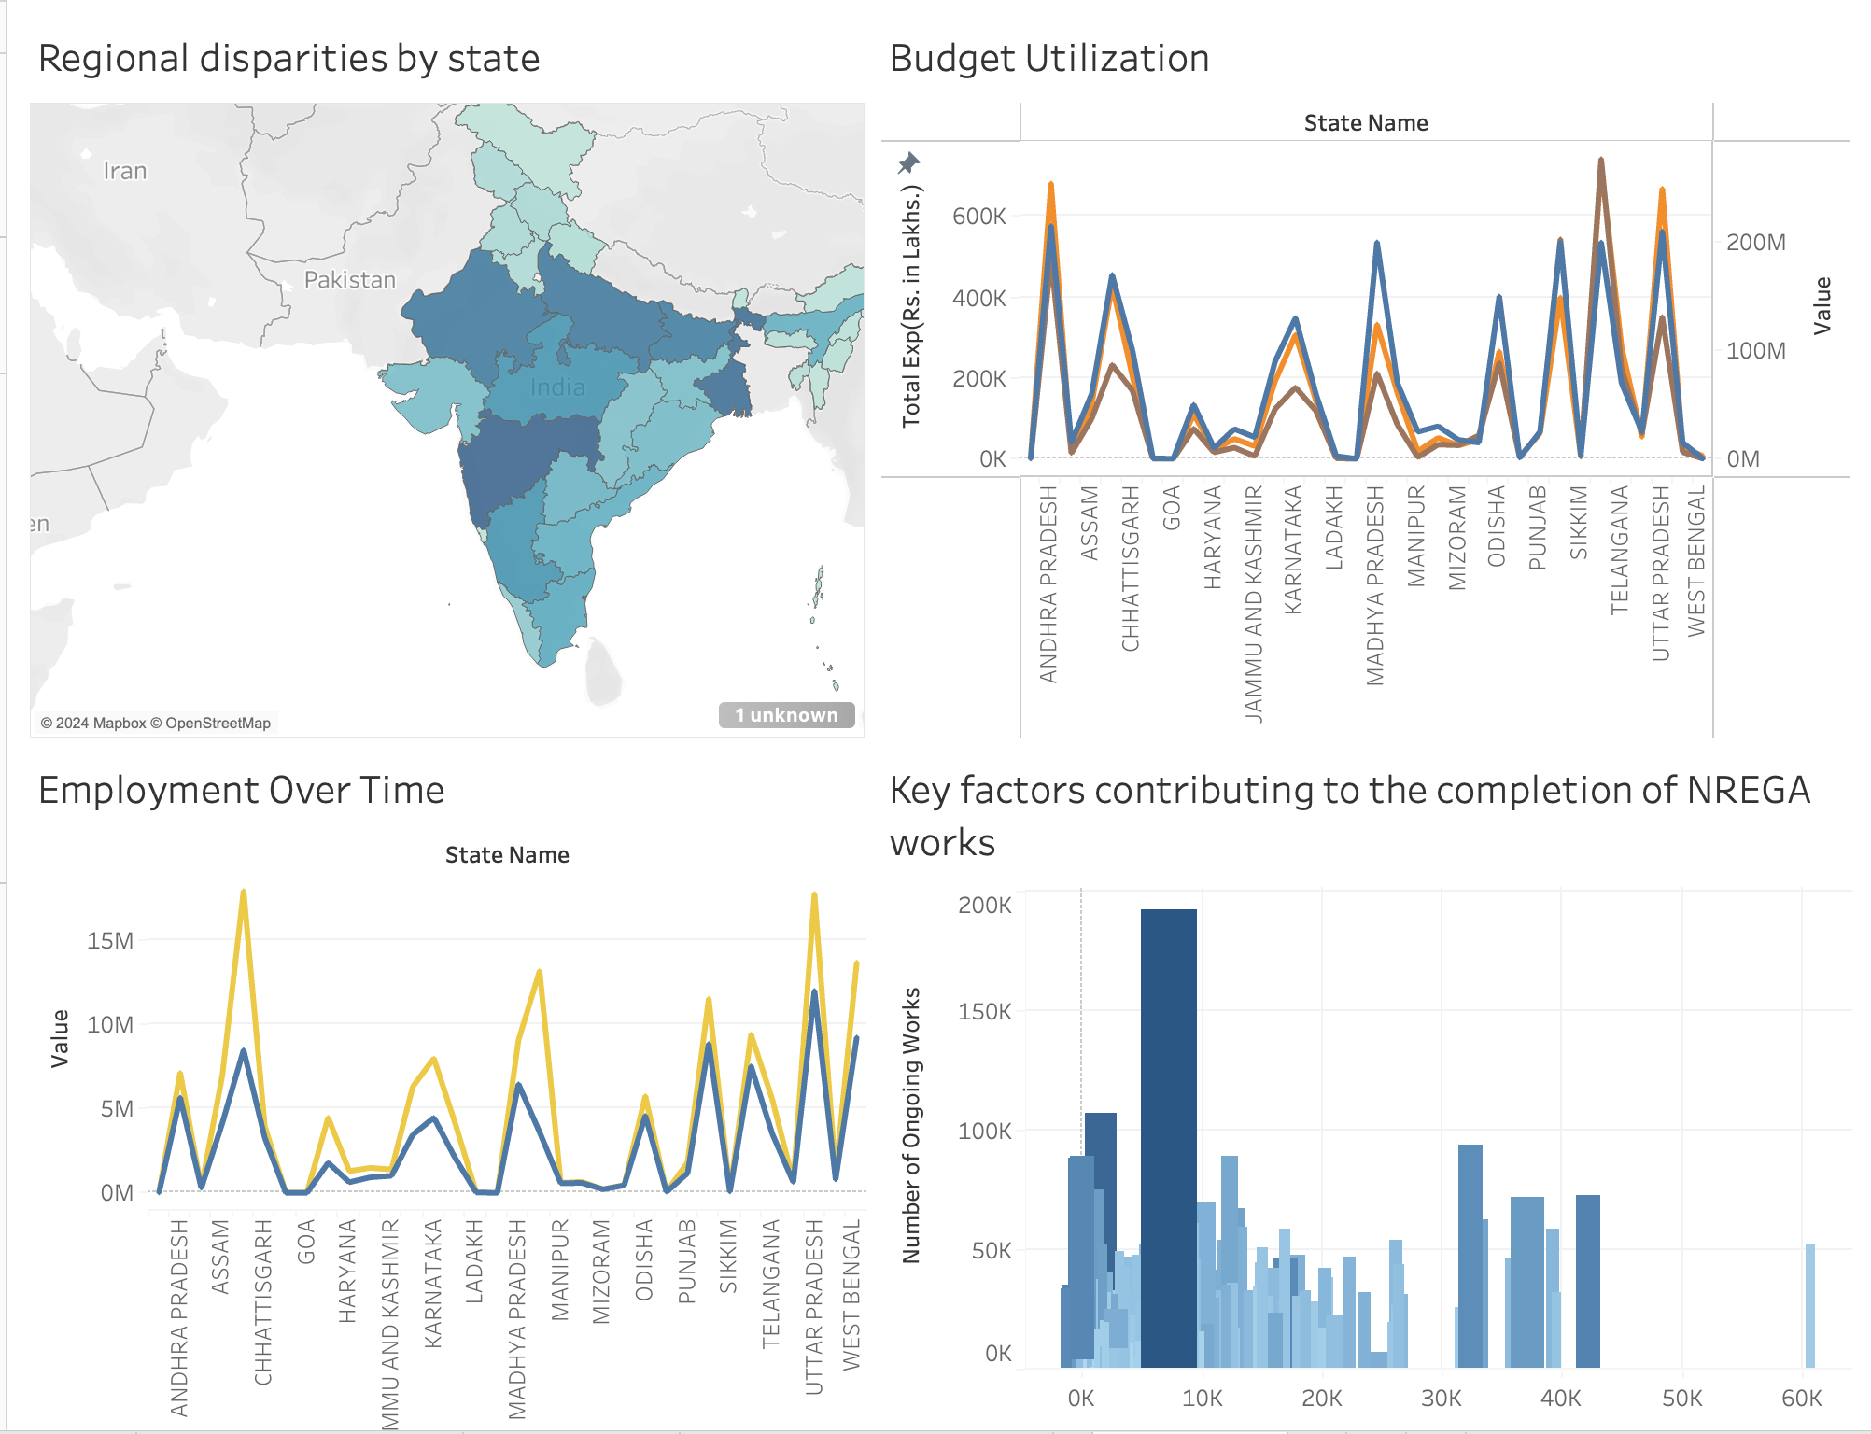
DASHBOARD
Mentorness| 2024
15

Slide 18

Mentorness | 2024
THANK YOU
Presented By : S Rohan

